Slide 1
ENIAC and Magist Case Study
Group presentation
Group members: Bruna, Eugen, Michele, Nils and Sibulele
Presenter: Sibulele
Eniac’s Brazilian Expansion

Slide 2
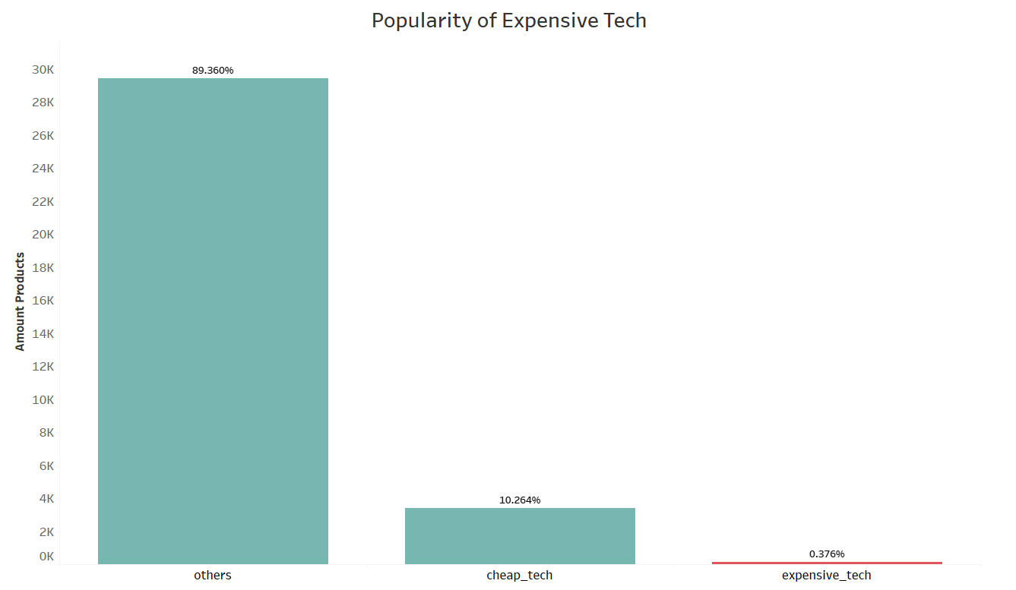
First glance- magist is not fulfilling many expensive tech products
item price >= 540€
considered categories: audio, computers, computers accessories,electronics,fixed telephony, tablets_printing_image

Slide 3
First glance- magist is not fulfilling many expensive tech products
Magist’s Sales
Non-Tech
Tech
90%
VS
10%
Average Item Price
Average Order Price
Magist
Eniac
Magist
Eniac
108€
VS
540€
137€
VS
710€
considered categories: audio, computers, computers accessories,electronics,fixed telephony, tablets_printing_image

Slide 4
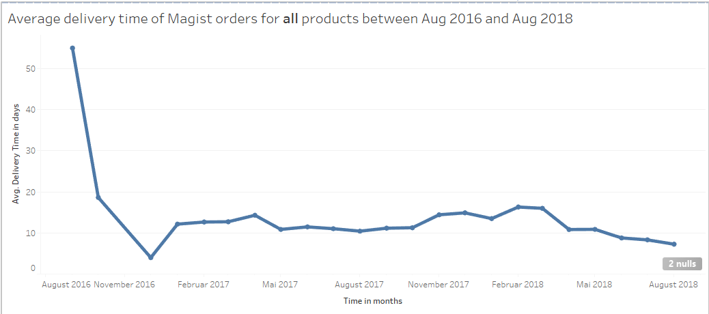
However, Magist offers fast deliveries
considered categories: all retail categories

Slide 5

Average Delivery times in Brazil
Usually, a company in Brazil delivers products within
16 days (in 2020)to all borders of the country.
Source: Statista 2021

Slide 6

In fact...
Magist database shows 93.09% of all orders were delivered, only 6.91% of orders were delayed, demonstrating great efficiency.

Slide 7


It is also a trusted Ally in Customer Experience
Average Review Score = 4 out 5 points
Average Review Answer Time = 3 days maximum

Slide 8
Final recommendation

Slide 9
Why Magist is the Right Choice for Eniac
For a 3 year trial the Pros outweigh the Cons
Pros: | Cons:
✅ Fast and Cheap Deliveries | ❌ Very little experience with high end tech products in terms of price and product catalogue
✅Great Customer Service
✅ Eniac still sets the price and product catalogue

Slide 10
Thank you for your attention!

Slide 11
Supporting Data (Appendix)

Slide 12
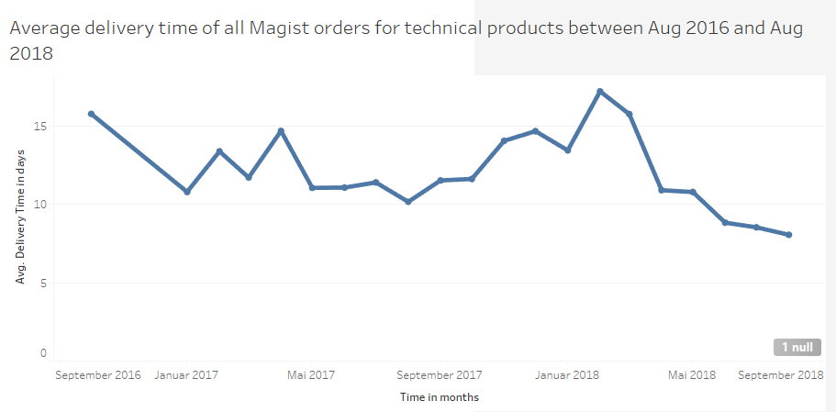
Average delivery times for technical products
considered categories: audio, computers, computers accessories,electronics,fixed telephony, tablets_printing_image

Slide 13
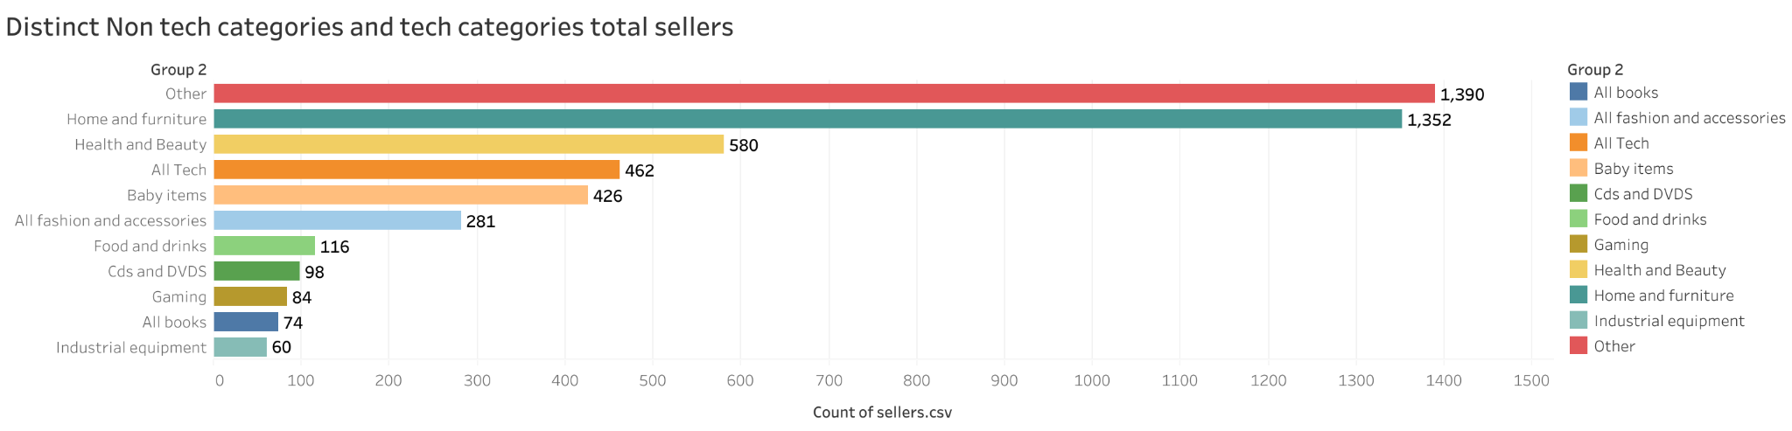
Tech vs. non-tech categories total sellers
considered tech categories: audio, computers, computers accessories,electronics,fixed telephony, tablets_printing_image

Slide 14
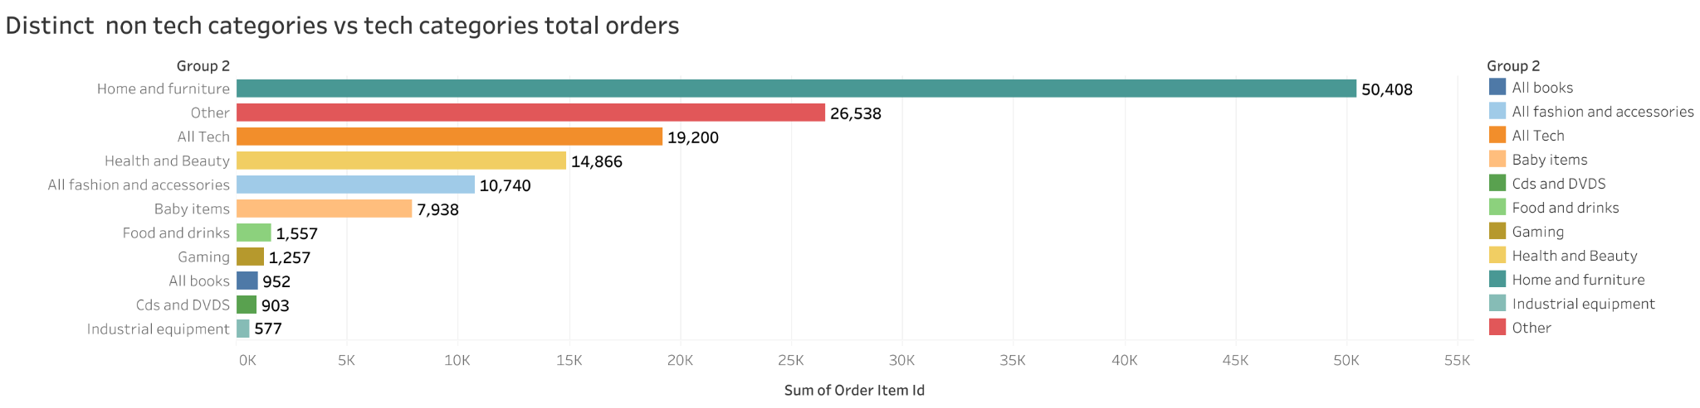
Tech vs. non-tech categories total orders
considered tech categories: audio, computers, computers accessories,electronics,fixed telephony, tablets_printing_image

Slide 15
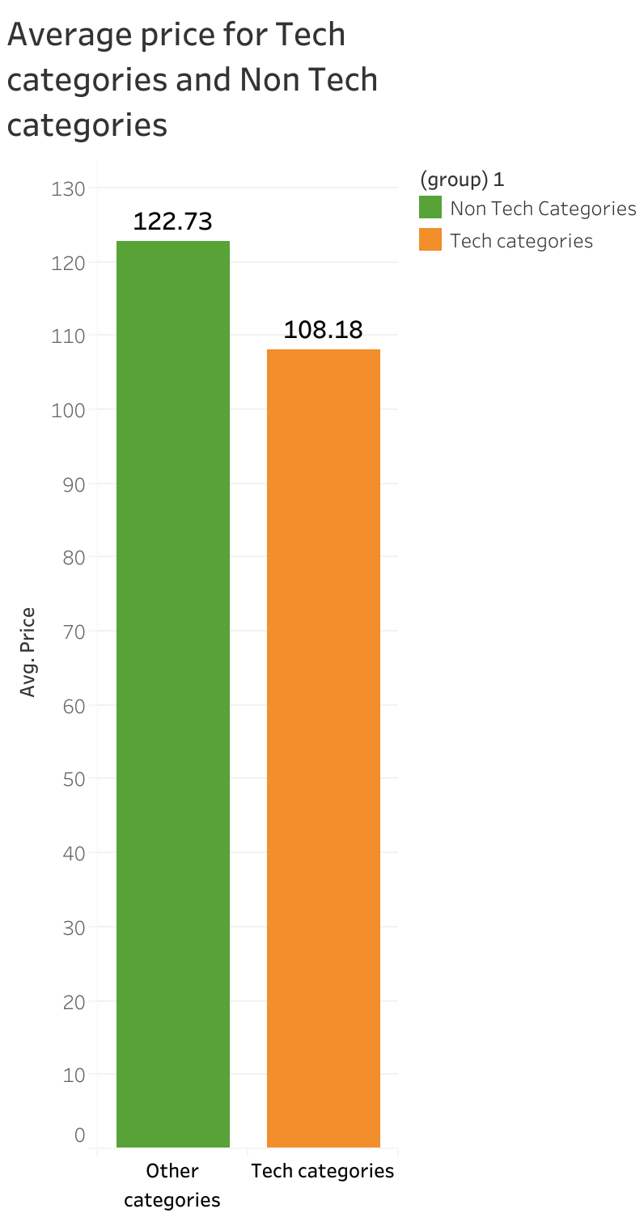
Average price (€) for tech and non tech products
considered tech categories: audio, computers, computers accessories,electronics,fixed telephony, tablets_printing_image

Slide 16
Average review score tech products
Average Review Score = 4 out 5 points
considered categories: audio, computers, computers accessories,electronics,fixed telephony, tablets_printing_image

Slide 17
General e-commerce data Brazil and Magist
Average delivery time in Brazil: 21 days march 2020, 16 days may 2020
Source: statista
Saas service offering for foreign ecommerce partners is relatively low and the major players are B2C platforms such as Mercado Livre and Amazon
Source: Eurotext
Other alternative such as Shopify also have a low average order value(Global) i.e. €185 in 2024
Source: Charleagency

